Slide 1

RETENCION– Customer Churn Management
HARMAN CONNECTED SERVICES
ENABLING A WORLD OF CONNECTED EXPERIENCES
Copyright © 2015 HARMAN. All rights reserved. CONFIDENTIAL AND PROPRIETARY

Slide 2
Objective
Objective: Build end to end analytical solution to help Telco's for customer retention
Solution Features:
Our solution will have ability to consume data from multiple sources
Customer Billing information
Customer complaints
CDR data
Signal strength data
Customer demography data
It will estimate PTC (Propensity to Churn prediction) for each customer
Data visualization on:
Customer risk profiling over time
Customer segments who are in high risk of churn by geography, demography product subscription etc
Factors affecting churn by each segment of customers

Slide 3
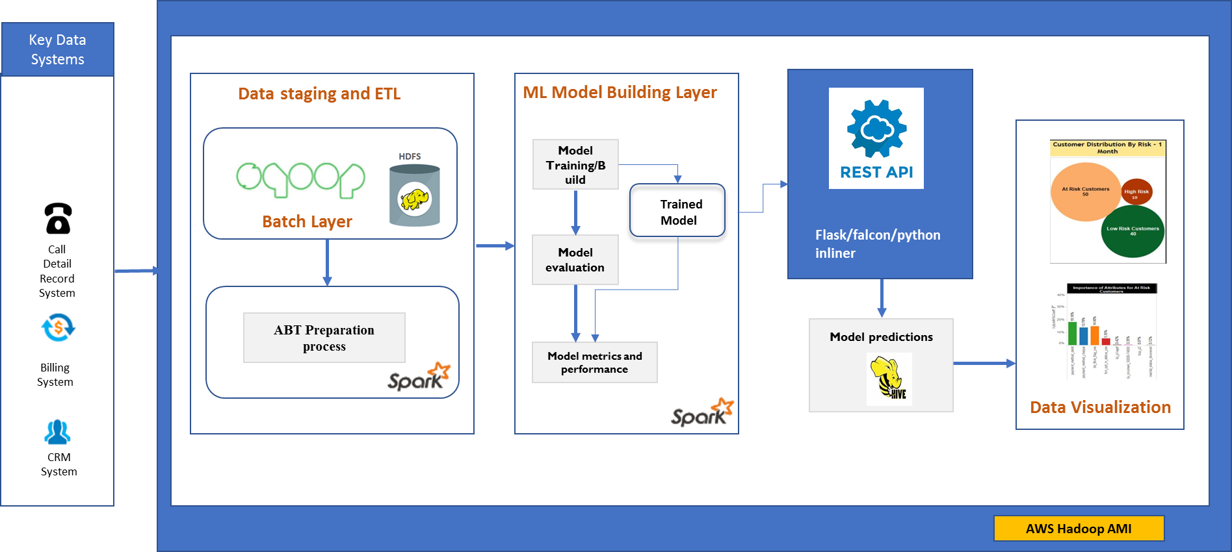

RETENCION - Solution Architecture

Slide 4
RETENCION - Project Plan
Week |  | 1 | 2 | 3 | 4
Milestone I | Infrastructure Set up
Subtask 1.1 | Development Environment set up
Subtask 1.2 | Hadoop Set up (Spark, Python, Hive, pySpark, Rest API)
Milestone II | Product Development
Task 1 | Data Creation & Understanding
Subtask 1.1 | Data Sourcing realted to chrun
Subtask 1.2 | Code Development for loading raw data into HDFS
Subtask 1.3 | correlation between dependent and independent variable
Subtask 1.4 | Missing & outlier value
Subtask 1.5 | Exploratiry Data Analysis
Subtask 1.6 | Testing and fixing the code
Task 2 | Data Preparation
Subtask 2.1 | Transformation
Subtask 2.2 | Missing & outlier treatment
Subtask 2.3 | Binning
Subtask 2.4 | Feature Engineering
Subtask 2.5 | Testing and fixing the code
Task 3 | Model Building
Subtask 3.1 | Code Development for selecting required classification Algorithm.
Subtask 3.2 | Model Deployment using Rest API
Subtask 3.3 | Backgroud processing and storing the output
Subtask 3.4 | Testing and fixing the code
Task 4 | Data Visualization
Subtask 4.1 | Propensity Segmentation for likelyhood to churn
Subtask 4.2 | Customer Profiling with each risk zone of attrition
Subtask 4.3 | Change in propensity over time (Based on data availability)

Slide 5
Infrastructure Requirement
AWS server

